Slide 1
CIRCULAR MOTION
The movement of an object in a circular path is known as circular motion. It can either be uniform or non- uniform.
If the magnitude of the velocity of the particle in circular motion remains constant , then it is called uniform circular motion.
Non uniform circular motion is one whose velocity is not constant

Slide 2
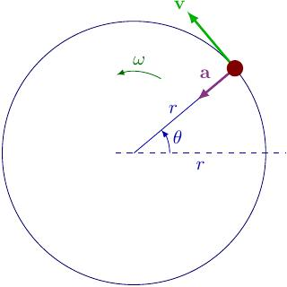

Slide 3
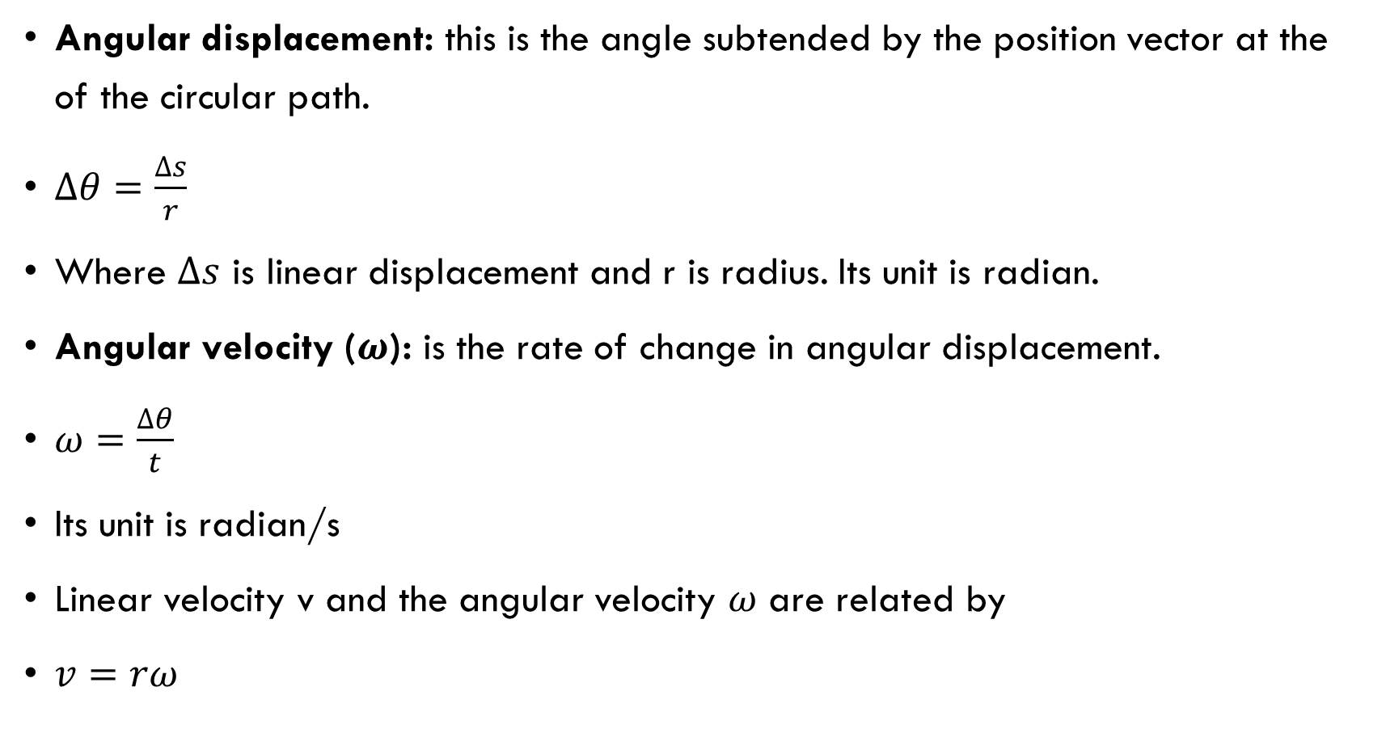
Variables in circular motion

Slide 4
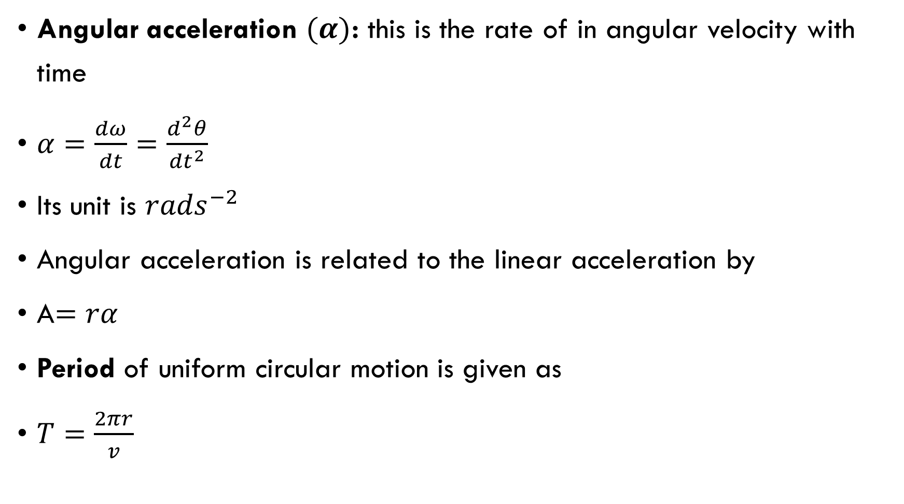

Slide 5
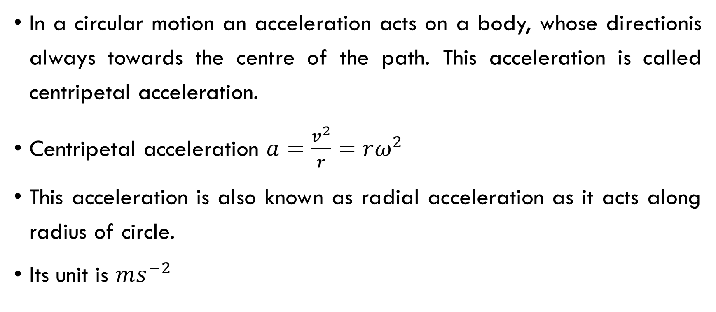
Centripetal acceleration

Slide 6
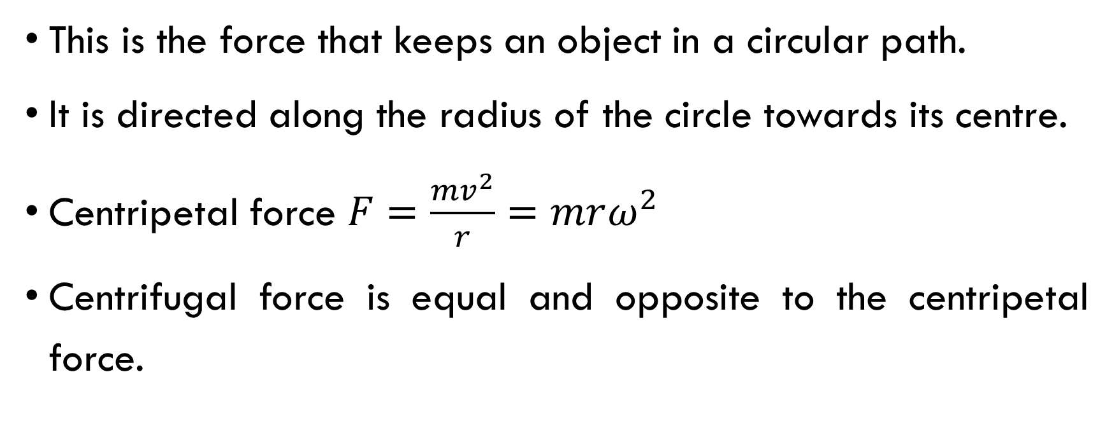
Centripetal Force

Slide 7
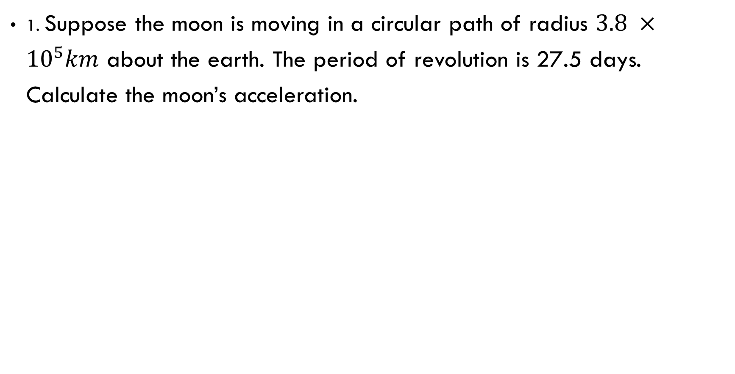
Examples

Slide 10
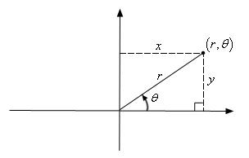
ROTATING CORDINATE SYSTEM
Coordinate system can be cartesian or polar.
The polar coordinate system is a two-dimensional coordinate system in which each point on a plane is determined by a distance from a reference point and an angle from a reference direction.
Here, instead of representing the point as (x, y), we can express it as a polar coordinate (r, θ).

Slide 11
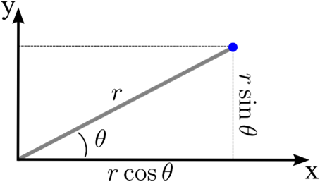
Cartesian to Polar Coordinates
x = r cos θ
y = r sin θ

Slide 12
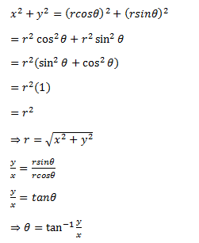
Finding r and θ using x and y:

Slide 13
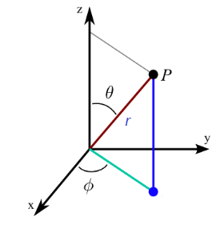
the 3d-polar coordinate or spherical coordinate system can be written as (r, φ, θ).
r = distance of from the origin
φ = the reference angle from xy-plane (in a counter-clockwise direction from the x-axis)
θ = the reference angle from z-axis

Slide 14
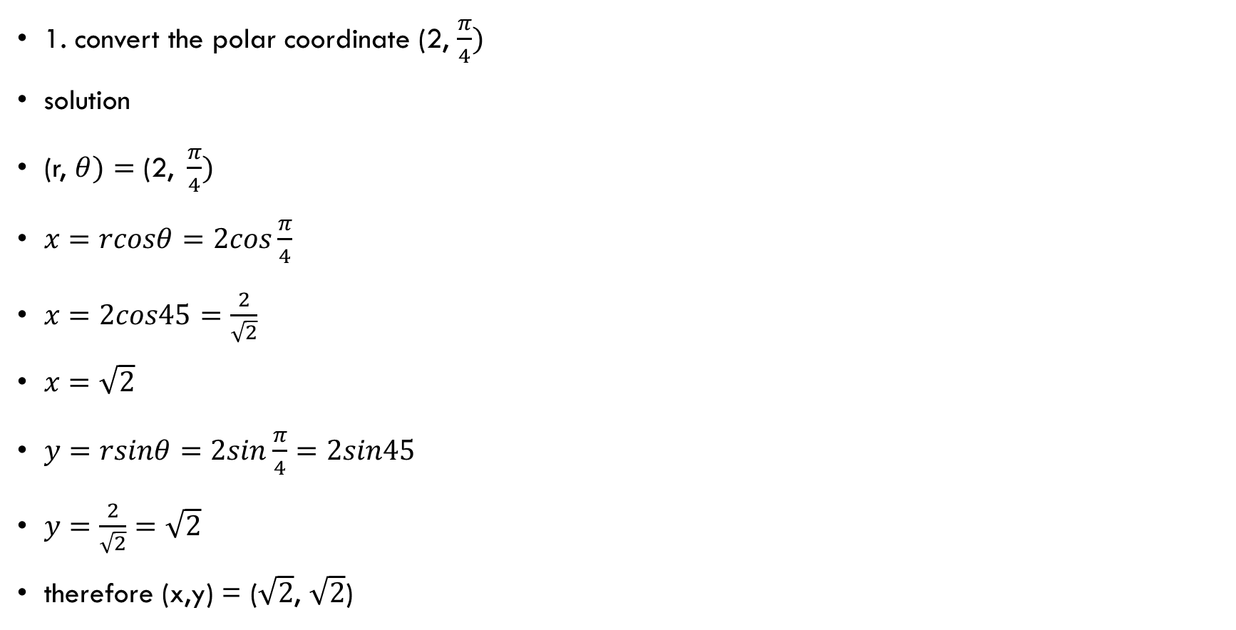
Examples

Slide 15
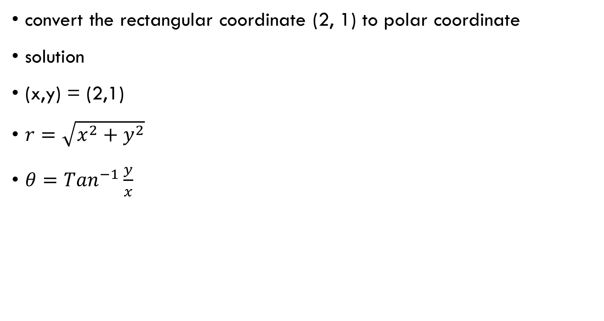

Slide 16
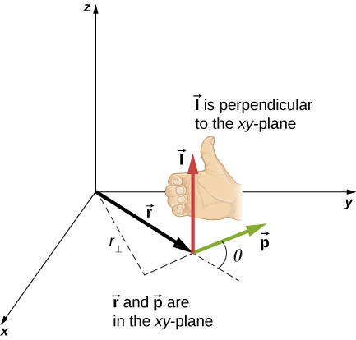
Angular Momentum
The angular momentum ,l, of a particle is defined as the cross-product of r and p, and is perpendicular to the plane containing r and p:
L=r×p.

Slide 17
